Slide 1

MTA Explaratory Data Analysis
By Raghad Aloraini
T5 data science bootcamp

Slide 2
Goals
See the effect of COVID-19 on the Metropolitan Transportation traffic.
Find the top 5 crowded stations.
Find the traffic for each day.

Slide 3
Methodologies
Using the data from The Metropolitan Transportation Authority website
I analysed 4 months of data starting from December 2019 till April 2020 before and after the pandemic.
Check for duplicated rows then drop them.
Calculate the number of daily entries and exits.
Calculate the daily traffic.
Group by top 5 crowded stations.
Group by weekdays traffic.

Slide 4
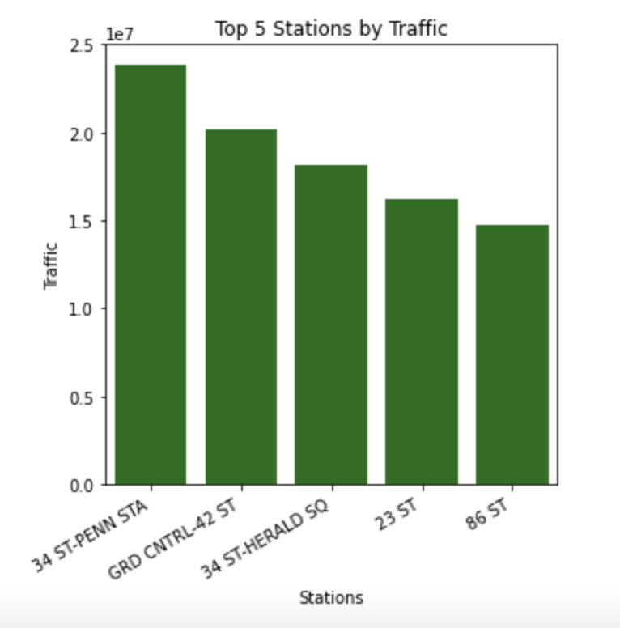
Key Findings
Top stations are the following:
34 ST-PENN STA
GRD CNTRL-42 ST
34 ST-HERALD SQ
23rd Street
86 ST

Slide 5
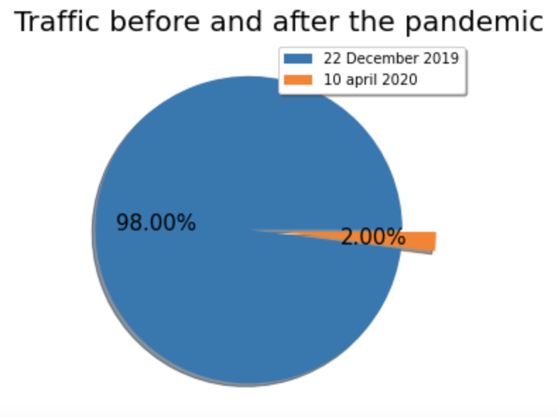
Key Findings
I choose specific turnstile from the top crowded station before and after COVID-19
Traffic decreased after COVID-19 by 98% and turns to only 2% of total traffic.

Slide 6
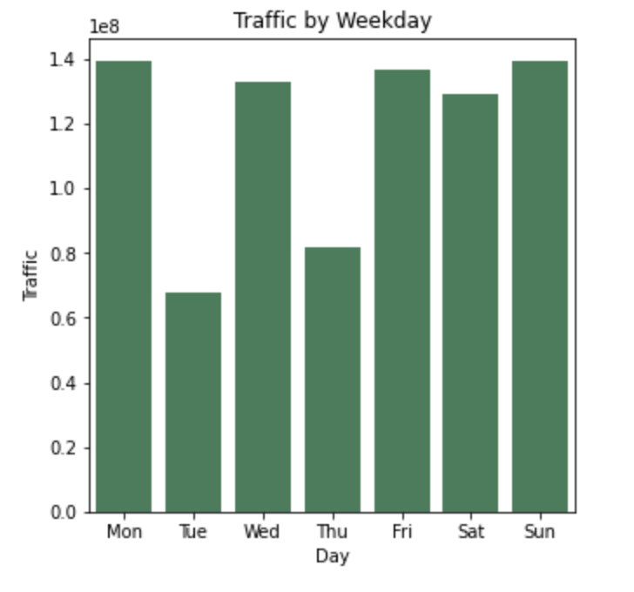
Key Findings
Monday, Wednesday, Friday, Saturday, Sunday generally see more traffic
Tuesday, thursday generally see less traffic

Slide 7
Conclusion
Using the data from The Metropolitan Transportation Authority website we concluded and found the following:
Top five stations by traffic are: 34 ST-PENN STAGRD CNTRL-42 ST , 34 ST-HERALD SQ , 23rd Street , 86 ST.
The Traffic after COVID-19 pandemic for the most crowded stations has decreased by 98%.
Most rushing weekdays are: Monday, Wednesday, Friday, Saturday, Sunday.

Slide 8
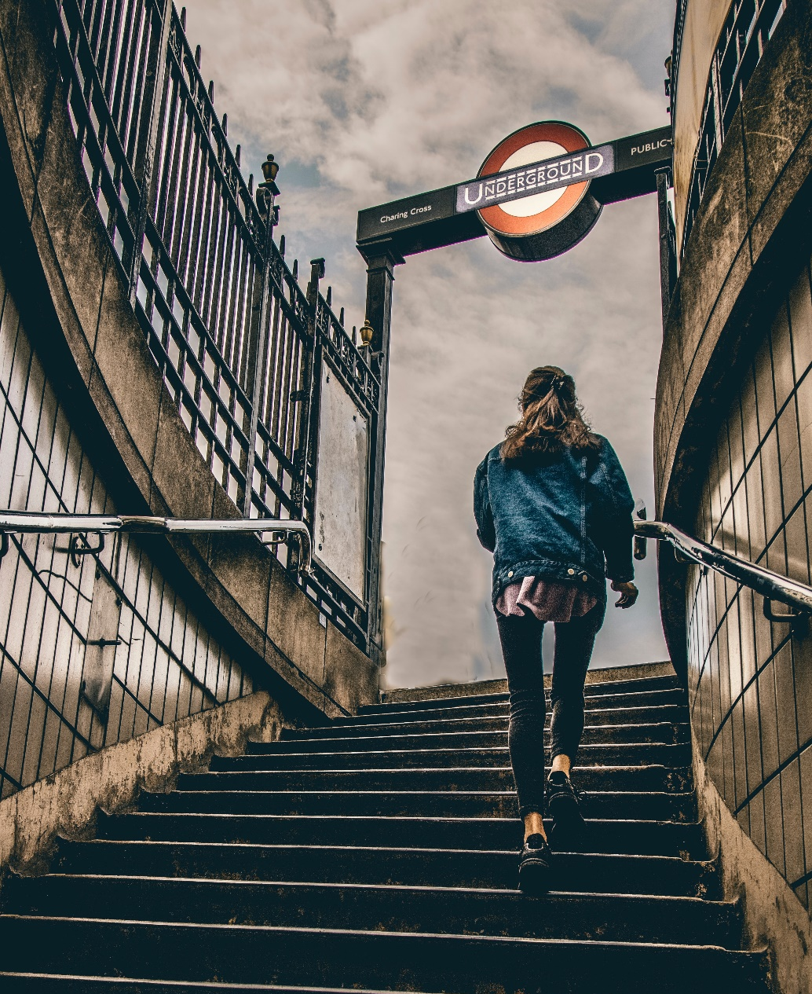
Thank You

